Slide 1
Collective and Individual Actions to Envision and Realize the Next Era of America’s Transportation Infrastructure
NCHRP 20-24 (138) Update
presented to
presented by
Nevada Transportation Conference
Susan Martinovich HNTB Corporation
May 8, 2024

Slide 2
The Story
What is it?
Why?
What’s done?
Where is it going?

Slide 3
We choose to go to the moon in this decade and do the other things, not because they are easy, but because they are hard. Because that goal will serve to organize and measure the best of our energies and skills, because that challenge is one that we’re willing to accept. One we are unwilling to postpone. And therefore, as we set sail, we ask God’s blessing on the most hazardous and dangerous and greatest adventure that man has ever gone
John F. Kennedy, 9/12/62
Notes:
Project initiated by State DOT CEO’s to ……….
Share example of original moonshot –talk about why this analogy was important to the panel – idea of having a common aspirational goa, and harnessing our collective energies toward itl.

Slide 4
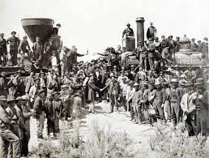
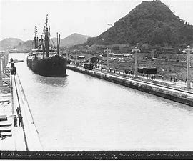
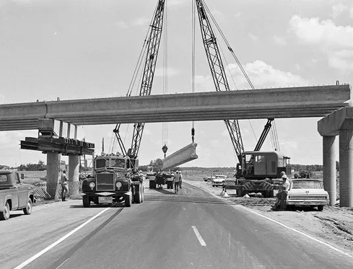
We Took a Look Back…
Notes:
Brief recap of work to date
Looked back at prior eras of transportation including what were ‘moonshots’ at the time – golden spike, Panama Canal, Interstate Highway System
Each of these moonshots reflected bold vision, strong leadership, and collaboration of many partners over a short period of time.
Moreover, in each case transportation was not the end, but the means to accomplish a national goal.
the Golden Spike was about connecting a nation together
the Panama Canal was about growing global trade
the Interstate Highway System was about interstate commerce and national defense
the moon landing was about restoring national confidence during the Cold War

Slide 5
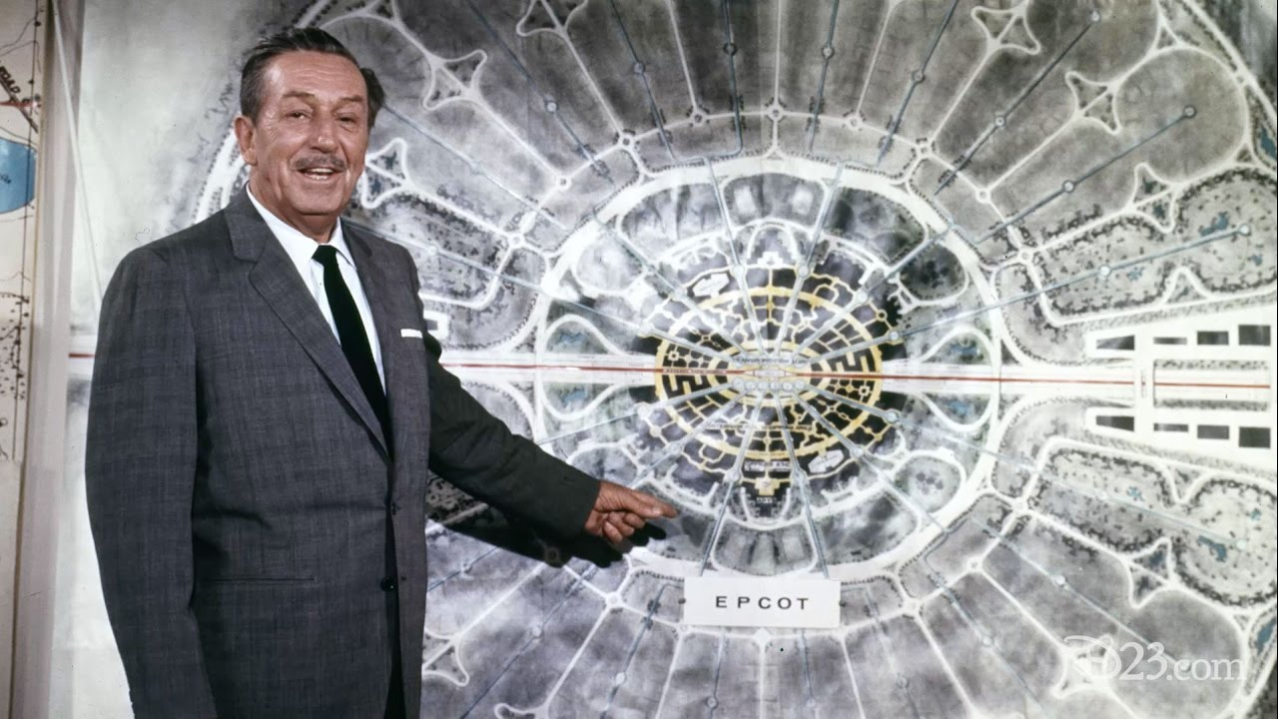
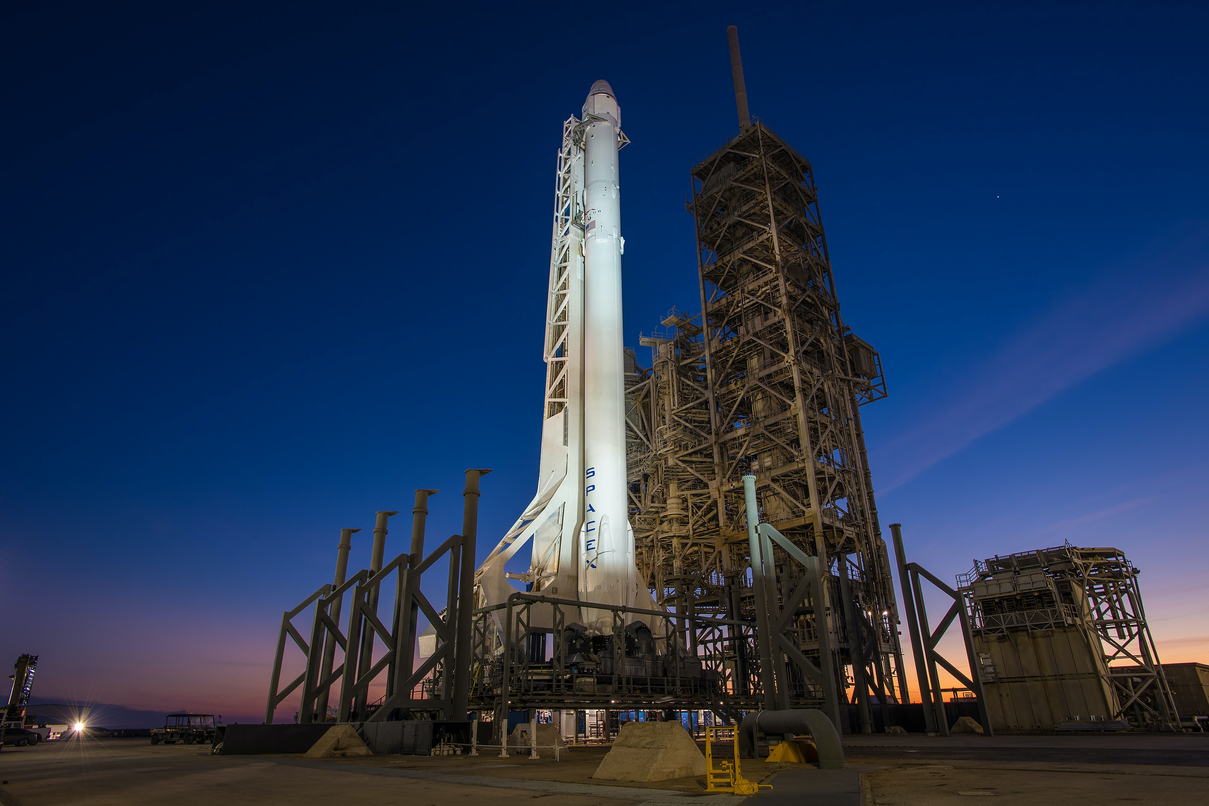
We looked at other Industries …
Notes:
Also looked at other industries that have undergone transformation – for example, tourism (Disney) or energy (renewables) or e-commerce (Google)
These transformations often were characterized by common practices that are relevant to state DOTs:
a focus on understanding, responding to, and where possible, shaping customer needs;
a bold vision supported by strong leadership and commitment throughout the organization;
the ingenuity to leverage emerging technologies to advance new business models and customer delivery options; and
strong collaboration with internal and external partners to accomplish change in short period of time.

Slide 6
We Examined Trends & Uncertainties…
Demographics
Prosperity
Future of Work
Trade & Logistics
Regions & Megaregions
Communities
Technology
Energy
Risk & Resilience
Civic & Governance Systems
Notes:
Several trends, uncertainties, and potential disruptions are converging to create opportunities and challenges for transportation agencies
We looked at trends in 10 categories- let me highlight a few that were important to the panel as we structured the vision

Slide 7
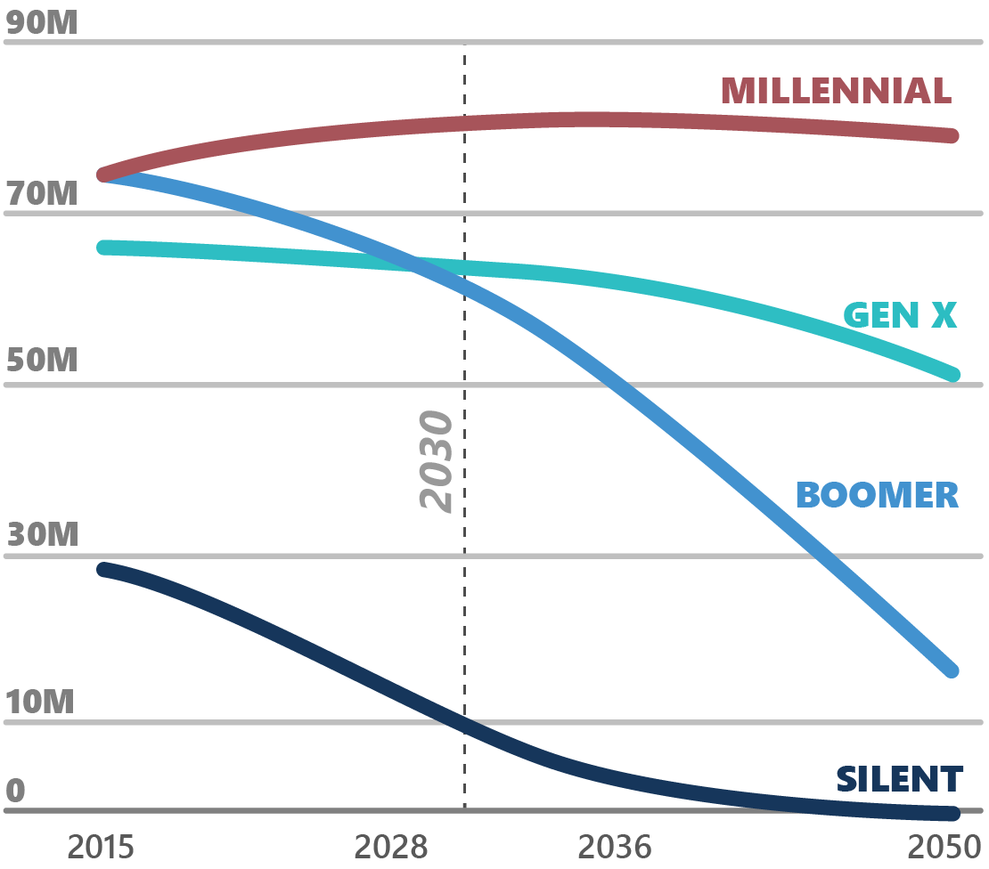
Population: Growing and Changing
Net immigration > natural increase (~2030)
More seniors than children (mid 2030s)
Non-Hispanic White <50% of total (2040s)
Source: Pew Research Center, 2020.
Notes:
.Although the pace of growth is slowing, the U.S. population is expected to continue to outpace most major industrialized nations due to strong immigration. The U.S. will achieve several major demographic turning points during the next few decades:
Net immigration expected to exceed national increase around 2030
More seniors than children for the first time in US history by mid 2030s
Non-Hispanic White population less than 50% of total by 2040s
(Source for all is Pew Research Center )

Slide 8
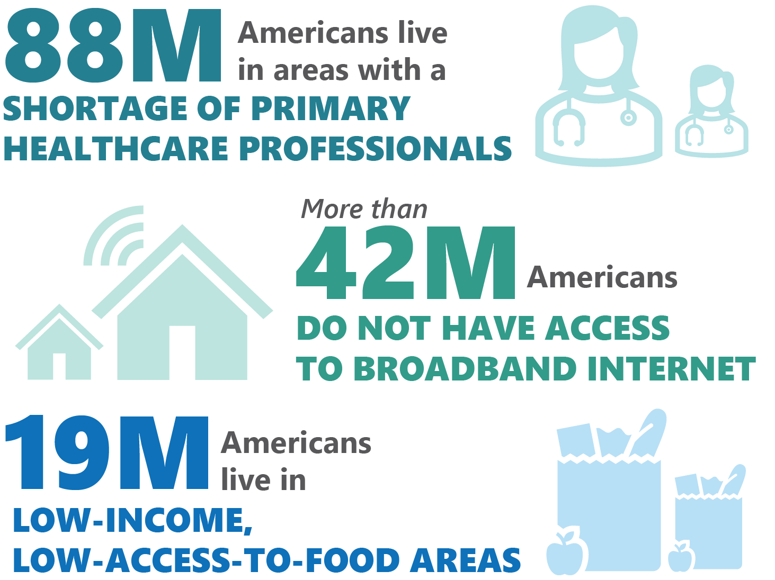
Prosperity: Leaving People behind?
13% of households earn incomes below the poverty line​
​29% are asset limited, income constrained and employed (ALICE)
Source: United for ALICE, 2021; Health Resources and Services Administration, 2021; Broadband Now, 2021; U.S. Department of Agriculture, 2019
Notes:
Looked at prosperity – concerns about people being left behind by growth – people without access to health care or education or fresh food or broadband.
One key statistic: our official poverty rate is reported by the Census a 13% of households; the United Way estimates that another 29% of households are people who are employed but have limited assets and income – the ‘working poor’
(Sources for infographic: Health Resources and Services Administration 2021; US Census 2019; Broadband Now 2021; US Department of Agriculture 2019

Slide 9
Technology: Transforming & Accelerating
What are the next “Moonshot” technologies?
2.5 quintillion bytes of data per day (2020)
64 billion connected IoT devices (2025)
$360 billion in artificial intelligence market (2028)
Computational Tech
Emotional AI
Brain Computer Interfaces
6G
Human Tech
Bionic Humans
Synthetic Biology
Immortality
Consumer Tech
Wireless Electricity
Holograms
Metaverse
eVTOL
Green Tech
Ocean- tech
Nextgen Batteries
Green Mining
Carbon Capture & Storage
Source: BoA Global Research, 2021.
Notes:
Looked at the rapid change in technology across the board- data, connectivity, automation, artificial intelligence- what many call Industry 4.0
(sources for stats on the left – Domo, 2020; National Intelligence Council, 2021; Fortune Business Insights, 2021)

Slide 10
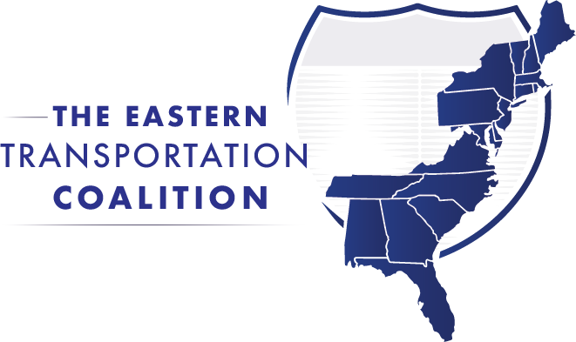
We engaged Many Partners…
Notes:
Engaged wide range of partners in a retreat- and along the way they became a ‘challenge network’

Slide 11
What’s Our Vision?
Community-centered transportation
A transportation system focused on connecting communities, moving people and goods, and meeting customer needs at all scales, from local to global – delivered as a partnership between state departments of transportation and other public, private, and civic sector partners.
Notes:
Emphasizes managing a comprehensive, multimodal transportation system that enables seamless end-to-end trips at all scales and supports community and economic development goals.
Focuses on how transportation can enhance and sustain the communities by providing a sense of security and stability, connectivity, and belonging

Slide 12
What’s Our Vision? Aspirational goals
Safe & Secure
Agile & Resilient
Accessible & Affordable
Community Centered Transportation
Clean & Sustainable
Seamless & Reliable
Healthy & Thriving
Notes:
Includes six aspirational goals that describe how the transportation system should function. Each state DOT may define success and define progress on each goal in a unique way.

Slide 13
Moonshots: What IF We…
Make aggressive progress toward Vision Zero?
Increase access to opportunity for ALICE households?
Create a mobility marketplace that works for our customers?
Notes:
We also defined seven “moonshot” concepts to move toward this vision. By a moonshot, we mean setting an audacious goal and identifying a breakthrough approach that DOTs could pursue individually or as a group. Some of these moonshots could involve major investments - for example, a nationwide digital infrastructure in Interstate highway right of way. Others might involve a series of smaller policy changes and partnerships that add up to significant change over time.
A quick review of the seven moonshots:
Make aggressive progress toward Vision zero- for example, reducing fatalities to post World War II levels by 2030 (about a 30% reduction) with momentum to hit zero beyond that.
Reducing the number of households that cannot meet basic survival costs- what is called ALICE (Asset Limited Income Constrained and Employed) through better transportation access to jobs, education, and health care.
Creating a mobility marketplace for customers to easily select and pay for the mobility services they need at any time.

Slide 14
Moonshots
Create a nationwide digital technology infrastructure?
Transform how we power the transportation system?
Rethink how we connect communities and regions?
Put communities at the center?
Notes:
Lighting up the Interstates- using our Interstate right of way to provide broadband and other enabling technologies coast to coast; this could be step one in a comprehensive effort to apply “Industry 4.0” technologies (connectivity, automation, etc.) to transportation.
Transforming transportation energy toward more clean and renewable sources- potentially making some corridors net generators of energy through pavement energy harvesting and solar panels in right of way.
Rethinking how we connect communities and regions- for example, rebuilding portions of the Interstate system and creating intercity rail connections.
Redesigning the planning process to put the community at the center.

Slide 15
Creating a Spectrum of actions/ Levers of change
External
Partnerships
Communications/customer service
Land use coordination
Multi-state/megaregional coordination
Internal
Policies/regulations
Plans/programs
Assets/right of way
Investments
Technology/data
Human resources
Organization/governance
Notes:
Final product is a spectrum of individual and collective actions for state DOT to move forward this vision.
We are organizing these actions by ‘lever of change’ – what can a state DOT control to bring about change – both internal and external

Slide 16
From Modest to Transformative… Plans/Programs
Increase emphasis on community vision/values in planning process
Redesign the planning process with community vision at the center

Slide 17
What’s DONE and WHERE Going?
2023+: Implementation
Conducted Moonshot discovery sessions with DOT’s – August 2023
Selected states for Moonshot implementation projects – October 2023
Launched 13 implementation projects – November 2023
Identifying individual and collective actions for state DOTs in collaboration with partners - ongoing

Slide 18
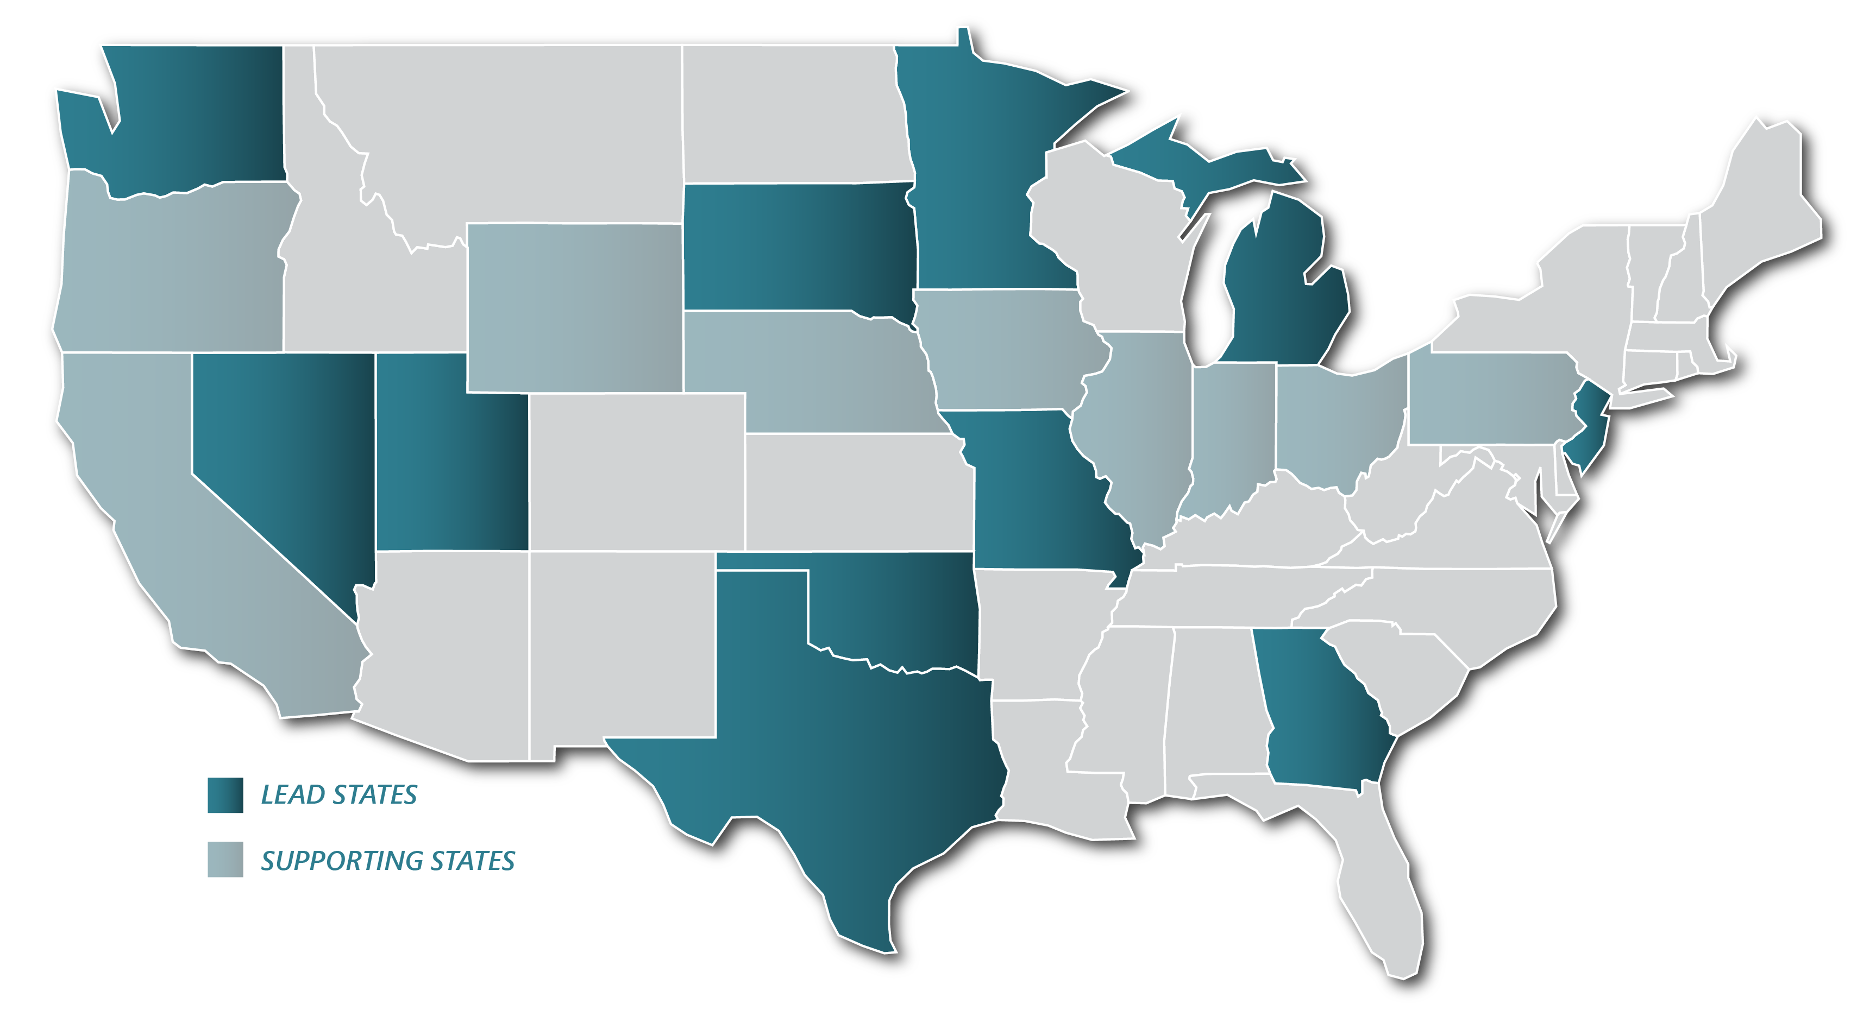
Initial Deployment States
Notes:
At least 16 states will be involved in the initial deployments – the 11 lead states are in dark green, with at least 9 more working as part of multi-state efforts. The brochure on your chair highlights these 11 states.
Six states- including Utah, as well as Georgia, Michigan, Minnesota, Nevada, and Texas, will focus on use of roadside right of way for digital and energy infrastructure. Nevada is leading a multi-state effort along the I-80 corridor (from CA to IA and beyond) that will demonstrate approaches for multi-state operations and data sharing. Our effort in Utah will develop and leverage a communications backbone to deploy and operate a broad range of digital services, with emphasis on safety and efficiency. With many states working in this area, we expect to demonstrate and assess multiple approaches and actions.
Three states – including New Jersey, Michigan and Oklahoma – will focus on improving access to opportunity for lower-income and vulnerable populations through use of technology, partnerships, and process changes.
Two states - New Jersey and South Dakota -- will focus specifically on new approaches for reducing fatalities and serious injuries – a topic that is a underlying emphasis of many other projects as well.
Washington State will demonstrate a new approach to connecting communities and regions as it integrates planning for multiple modes including high speed rail, transit, highways, and advanced air mobility along the Cascadia Corridor with Oregon and British Columbia.
And Missouri will incorporate all seven moonshot concepts into its project to rebuild and renew I-70 between St. Louis and Kansas City.

Slide 19
Initial Deployments: Technology Focus
NV
TX
GA
UT
Expand I-80 Coalition (CA to NE) further east
Pilot next generation of multi-state corridor operations and data sharing
Install broadband along all Interstates in UT
Deploy and operate broad range of digital devices and services
Establish innovation corridor on I-45; transition to I-35 and I-10
Advance real-time system operations in seamlessly connected environment
Deploy connected vehicle technology and broadband along all Interstates in GA.
Set up P3 to provide open access
Notes:
Patrick
We will now briefly review the other 12 initial deployments. I am going to ask a few of the 20-24 panel members to assist me. First, Tracy Larkin will cover the deployments related to technology and energy.
Tracy
Six lead states will focus on use of roadside right of way for digital and energy infrastructure. With many states working in this area, we expect to demonstrate and assess multiple approaches and actions.
Add a few more comments.
Call on remaining states to speak briefly about their project:
UT (Carlos, if still there)
GA (Russell)
TX (Marc)
MI (Brad)
MN (Nancy)
Brief discussion among board members. Keep to no more than 45 min.

Slide 20
Initial Deployments: Energy Focus
MN
MI
Expand use of highway rights of way for transmission to support clean energy transition
Study how to power combined charging ports along Alternative Fuel Corridors
Find ideal locations for roadside solar power plants
Identify opportunities for new and diversified revenues
Notes:
Patrick
We will now briefly review the other 12 initial deployments. I am going to ask a few of the 20-24 panel members to assist me. First, Tracy Larkin will cover the deployments related to technology and energy.
Tracy
Six lead states will focus on use of roadside right of way for digital and energy infrastructure. With many states working in this area, we expect to demonstrate and assess multiple approaches and actions.
Add a few more comments.
Call on remaining states to speak briefly about their project:
UT (Carlos, if still there)
GA (Russell)
TX (Marc)
MI (Brad)
MN (Nancy)
Brief discussion among board members. Keep to no more than 45 min.

Slide 21
Initial Deployments: Access to Opportunity Focus
OK
MI
NJ
Implement Statewide Mobility Management Program to address unmet mobility needs of vulnerable individuals
Unify state and federal funding sources for mobility services
Create a mobility marketplace, including mobility wallets that combine funds from multiple sources
Consider impacts on ALICE households on every project entering concept development
Coordinate with partners to help improve access to opportunity for ALICE households
Notes:
Patrick
Introduce Diane to talk about next group of states.
Diane
Four states (in dark green) are focusing on topics related to connecting communities and providing access to opportunity.
Brief comments on NJ ALICE project.
Then introduce remaining states to comment on their project:
MI (Brad)
OK (Tim)
WA (Roger)
Then take a few BOD questions if time- keep to 15 min

Slide 22
Initial Deployments: Community Focus
WA
Combine planning for I-5 and high-speed rail along western WA, OR, BC
Create multimodal options and transform role of transportation in surrounding communities
Notes:
Patrick
Introduce Diane to talk about next group of states.
Diane
Four states (in dark green) are focusing on topics related to connecting communities and providing access to opportunity.
Brief comments on NJ ALICE project.
Then introduce remaining states to comment on their project:
MI (Brad)
OK (Tim)
WA (Roger)
Then take a few BOD questions if time- keep to 15 min

Slide 23
Initial Deployments: Safety Focus
SD
NJ
Develop and deploy innovative rural measures to reduce serious injury and fatal crashes
Deploy Red Clearance Extension System to reduce conflicts between vehicles, pedestrians, and cyclists
Notes:
Patrick
Two deployments will focus specifically on Vision Zero. Several other projects including our I-70 effort plus the digital infrastructure initiatives also will support safety – and I believe many others on our list ultimately will consider safety in their approach.
Ask Joel (SD) and Diane (NJ) for brief comments

Slide 24
Initial Deployment States: Integrated approach
MO
Advance Improve I-70 Program to deliver a safer, more efficient, and more resilient Interstate across Missouri

Slide 25
What We’ve Been Learning
Focus on customer
Technology as enabler
Critical role of partnerships – to leverage us and to challenge us
Big and small solutions
No one size fits all approach; individual and collective actions
Need for internal change: workforce, governance, data, process

Slide 26
What’s Next?
Work with initial deployment states to demonstrate progress and refine Moonshot concepts
Continue to build out spectrum of individual and collective actions for state DOTs
Continue to engage with “Challenge Network” of non-traditional partners
Share results and resources with all states; bring in next cohort
Continue strong coordination with TRB, USDOT, other partners
Notes:
We are excited about launching this initial group of states.
During the next year, we will be working with the states to
Demonstrate progress and refine the concepts for what we can achieve by 2030.
Continue to build out the spectrum of actions for use by all 52 state DOTs.
Continue to engage with the “Challenge Network” of non-traditional partners we assembled in Phase 1.
Share results, tools, and resources with all states and prepare to bring in a new cohort of states.
Continue strong coordination with TRB, USDOT and other partners. As you may have seen in other sessions this week as Victoria has unveiled the new TRB Critical Issues in Transportation report and USDOT has talked about their R&T Strategic Plan, there’s tremendous alignment across organizations right now around key goals and approaches, including the focus on customer/public value; the role of transformational technology and the need to prepare the transportation agency for the future .

Slide 27
Thank you Susan Martinovich msmartinovich@hntb.com 775.720.2696

